Slide 1
OS Structure
Chitkara University Institute of Engineering and Technology,
Chitkara University, Punjab

Slide 2
Content
Operating System Structures
Types of Operating System Structures
Simple Structure, Monolithic Structure, Micro-Kernel Structure, Hybrid-Kernel Structure, Exo-Kernel Structure, Layered Structure, Modular Structure, Virtual Machines
Components of Operating System
Kernel, Shell
Operating System Services
User Operating System Interface
System Calls
Types of System Calls
System Programs
Notes:
2

Slide 3
Operating Systems Structures
A system structure for an operating system is like the blueprint of how an OS is organized and how its different parts interact with each other. Because operating systems have complex structures, we want a structure that is easy to understand so that we can adapt an operating system to meet our specific needs. Similar to how we break down larger problems into smaller, more manageable subproblems, building an operating system in pieces is simpler.
The operating system is a component of every segment. The strategy for integrating different operating system components within the kernel can be thought of as an operating system structure.

Slide 4
Types of Operating Systems Structures
Depending on this, we have the following structures in the operating system:
Simple Structure
Monolithic Structure
Micro-Kernel Structure
Hybrid-Kernel Structure
Exo-Kernel Structure
Layered Structure
Modular Structure
Virtual Machines

Slide 5
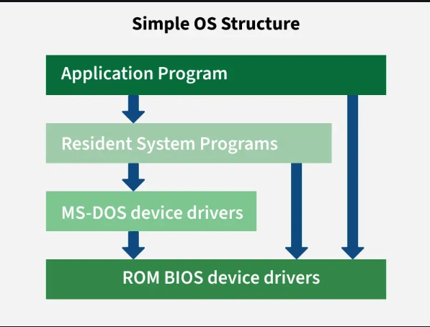
Simple Structure
Simple structure operating systems do not have well-defined structures and are small, simple, and limited. The interfaces and levels of functionality are not well separated. MS-DOS is an example of such an operating system. In MS-DOS, application programs are able to access the basic I/O routines. These types of operating systems cause the entire system to crash if one of the user programs fails.
+-------------------+
| User / Apps |
+-------------------+
| Simple OS (basic) |
+-------------------+
| Hardware |
+-------------------+
Figure 6: Simple Structure of OS

Slide 6
Cont…….
Advantages of Simple Structure
It delivers better application performance because of the few interfaces between the application program and the hardware.
It is easy for kernel developers to develop such an operating system.
Disadvantages of Simple Structure
No clear boundaries exist between modules.
It does not enforce data hiding in the operating system.

Slide 7
Monolithic Structure
A monolithic structure is a type of operating system architecture where the entire operating system is implemented as a single large process in kernel mode. Essential operating system services, such as process management, memory management, file systems, and device drivers, are combined into a single code block.
Advantages of Monolithic Structure
Performance of Monolithic structure is fast as since everything runs in a single block, therefore communication between components is quick.
It is easier to build because all parts are in one code block.
Disadvantges of Monolithic Architecture
It is hard to maintain as a small error can affect entire system.
There are also some security risks in the Monolithic architecture.

Slide 8
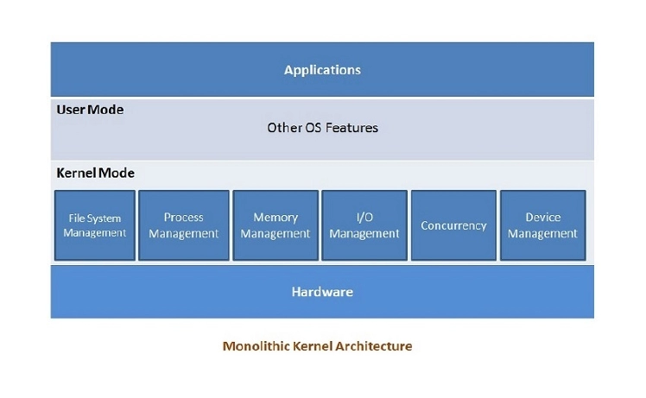
+---------------------------+
| User Apps |
+---------------------------+
| MONOLITHIC KERNEL |
| - Process Mgmt |
| - Memory Mgmt |
| - File System |
| - Device Drivers |
| - I/O Mgmt |
+---------------------------+
| Hardware |
+---------------------------+

Slide 9
Micro-Kernel Structure
Micro-Kernel structure designs the operating system by removing all non-essential components from the kernel and implementing them as system and user programs. This results in a smaller kernel called the micro-kernel. Advantages of this structure are that all new services need to be added to user space and does not require the kernel to be modified. Thus it is more secure and reliable as if a service fails, then rest of the operating system remains untouched. Mac OS is an example of this type of OS.
Advantages of Micro-kernel Structure
It makes the operating system portable to various platforms.
As microkernels are small so these can be tested effectively.
Disadvantages of Micro-kernel Structure
Increased level of inter module communication degrades system performance.

Slide 10
Hybrid-Kernel Structure
Hybrid-Kernel structure is nothing but just a combination of both monolithic-kernel structure and micro-kernel structure. Basically, it combines properties of both monolithic and micro-kernel and make a more advance and helpful approach. It implement speed and design of monolithic and modularity and stability of micro-kernel structure.
Advantages of Hybrid-Kernel Structure
It offers good performance as it implements the advantages of both structure in it.
It supports a wide range of hardware and applications.
It provides better isolation and security by implementing micro-kernel approach.
It enhances overall system reliability by separating critical functions into micro-kernel for debugging and maintenance.
Disadvantages of Hybrid-Kernel Structure
It increases overall complexity of system by implementing both structure (monolithic and micro) and making the system difficult to understand.
The layer of communication between micro-kernel and other component increases time complexity and decreases performance compared to monolithic kernel.

Slide 11
Exo-Kernel Structure
Exokernel is an operating system developed at MIT to provide application-level management of hardware resources. By separating resource management from protection, the exokernel architecture aims to enable application-specific customization. Due to its limited operability, exokernel size typically tends to be minimal.
The OS will always have an impact on the functionality, performance, and scope of the apps that are developed on it because it sits in between the software and the hardware. The exokernel operating system makes an attempt to address this problem by rejecting the notion that an operating system must provide abstractions upon which to base applications. The objective is to limit developers use of abstractions as little as possible while still giving them freedom.

Slide 12
Cont….
Advantages of Exo-Kernel
Support for improved application control.
Separates management from security.
It improves the performance of the application.
A more efficient use of hardware resources is made possible by accurate resource allocation and revocation.
It is simpler to test and create new operating systems.
Each user-space program is allowed to use a custom memory management system.
Disadvantages of Exo-Kernel
A decline in consistency.
Exokernel interfaces have a complex architecture.

Slide 13
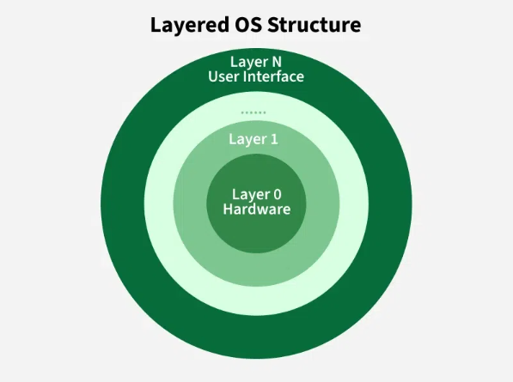
Layered Structure
An OS can be broken into pieces and retain much more control over the system. In this structure, the OS is broken into a number of layers (levels).
The bottom layer (layer 0) is the hardware, and the topmost layer (layer N) is the user interface. These layers are so designed that each layer uses the functions of the lower-level layers. This simplifies the debugging process, if lower-level layers are debugged and an error occurs during debugging, then the error must be on that layer only, as the lower-level layers have already been debugged.
The main disadvantage of this structure is that at each layer, the data needs to be modified and passed on which adds overhead to the system. Moreover, careful planning of the layers is necessary, as a layer can use only lower-level layers. UNIX is an example of this structure.
+---------------------------+
| User Apps |
+---------------------------+
| User Interface |
+---------------------------+
| System Services |
+---------------------------+
| OS Kernel |
+---------------------------+
| Hardware Drivers |
+---------------------------+
| Hardware |
+---------------------------+
Figure 7: Layered OS

Slide 14
Cont…….
Advantages of Layered Structure
Layering makes it easier to enhance the operating system, as the implementation of a layer can be changed easily without affecting the other layers.
It is very easy to perform debugging and system verification.
Disadvantages of Layered Structure
In this structure, the application’s performance is degraded as compared to simple structure.
It requires careful planning for designing the layers, as the higher layers use the functionalities of only the lower layers.

Slide 15
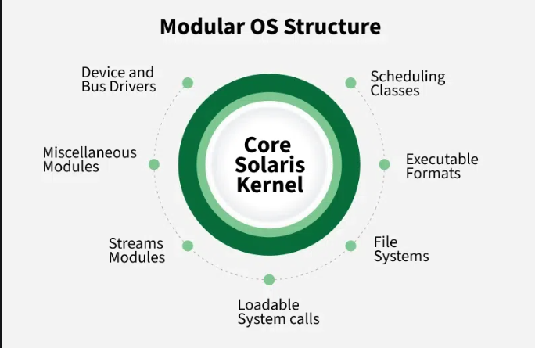
Modular Structure
It is considered as the best approach for an OS. It involves designing of a modular kernel. The kernel has only a set of core components and other services are added as dynamically loadable modules to the kernel either during runtime or boot time. It resembles layered structure due to the fact that each kernel has defined and protected interfaces, but it is more flexible than a layered structure as a module can call any other module. For example Solaris OS is organized as shown in the figure.
Figure 8:Modular OS Structure

Slide 16
Virtual Machines (VMs)
Based on our needs, a virtual machine abstracts the hardware of our personal computer, including the CPU, disc drives, RAM, and NIC (Network Interface Card), into a variety of different execution contexts, giving us the impression that each execution environment is a different computer. An illustration of it is a virtual box.
An operating system enables us to run multiple processes concurrently while making it appear as though each one is using a different processor and virtual memory by using CPU scheduling and virtual memory techniques.
The fundamental issue with the virtual machine technique is disc systems. Let’s say the physical machine only has three disc drives, but it needs to host seven virtual machines. The program that creates virtual machines would need a significant amount of disc space in order to provide virtual memory and spooling, so it should be clear that it is impossible to assign a disc drive to every virtual machine. The answer is to make virtual discs available.

Slide 17
Components of an Operating Systems
There are two fundamental components of an Operating System.
Shell
Kernel
Shell
Shell is the outermost layer of the Operating System and it handles the interaction with the user. The main task of the Shell is the management of interaction between the User and OS. Shell provides better communication with the user and the Operating System Shell does it by giving proper input to the user it also interprets input for the OS and handles the output from the OS. It works as a way of communication between the User and the OS.
Kernel
The kernel is one of the components of the Operating System which works as a core component. The rest of the components depends on Kernel for the supply of the important services that are provided by the Operating System. The kernel is the primary interface between the Operating system and Hardware.

Slide 18
Cont……
Functions of Kernel
It helps in controlling the System Calls.
It helps in I/O Management.
It helps in the management of applications, memory, etc.
Types of Kernel
There are four types of Kernel that are mentioned below.
Monolithic Kernel
Microkernel
Hybrid Kernel
Exokernel

Slide 19
Operating System Services
Operating systems provide an environment for execution of programs and services to programs and users
One set of operating-system services provides functions that are helpful to the user:
User interface - Almost all operating systems have a user interface (UI).
Varies between Command-Line (CLI), Graphics User Interface (GUI), Batch Interface
Program execution - The system must be able to load a program into memory and to run that program, end execution, either normally or abnormally (indicating error)
I/O operations - A running program may require I/O, which may involve a file or an I/O device
Notes:
19

Slide 20
Operating System Services (Cont.)
One set of operating-system services provides functions that are helpful to the user (Cont.):
File-system manipulation - The file system is of particular interest. Programs need to read and write files and directories, create and delete them, search them, list file Information, permission management.
Communications – Processes may exchange information, on the same computer or between computers over a network
Communications may be via shared memory or through message passing (packets moved by the OS)
Error detection – OS needs to be constantly aware of possible errors
May occur in the CPU and memory hardware, in I/O devices, in user program
For each type of error, OS should take the appropriate action to ensure correct and consistent computing
Debugging facilities can greatly enhance the user’s and programmer’s abilities to efficiently use the system
Notes:
20

Slide 21
Operating System Services (Cont.)
Another set of OS functions exists for ensuring the efficient operation of the system itself via resource sharing
Resource allocation - When multiple users or multiple jobs running concurrently, resources must be allocated to each of them
Many types of resources - CPU cycles, main memory, file storage, I/O devices.
Accounting - To keep track of which users use how much and what kinds of computer resources
Protection and security - The owners of information stored in a multiuser or networked computer system may want to control use of that information, concurrent processes should not interfere with each other
Protection involves ensuring that all access to system resources is controlled
Security of the system from outsiders requires user authentication, extends to defending external I/O devices from invalid access attempts
Notes:
21

Slide 22
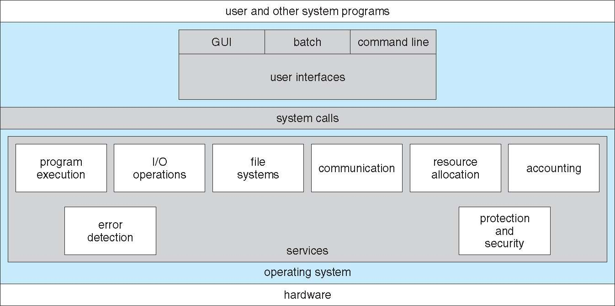
A View of Operating System Services

Slide 23
User Operating System Interface - CLI
CLI or command interpreter allows direct command entry
Sometimes implemented in kernel, sometimes by systems program
Sometimes multiple flavors implemented – shells
Primarily fetches a command from user and executes it
Sometimes commands built-in, sometimes just names of programs
If the latter, adding new features doesn’t require shell modification
Notes:
23

Slide 24
User Operating System Interface - GUI
User-friendly desktop metaphor interface
Usually mouse, keyboard, and monitor
Icons represent files, programs, actions, etc
Various mouse buttons over objects in the interface cause various actions (provide information, options, execute function, open directory (known as a folder)
Invented at Xerox PARC
Many systems now include both CLI and GUI interfaces
Microsoft Windows is GUI with CLI “command” shell
Apple Mac OS X is “Aqua” GUI interface with UNIX kernel underneath and shells available
Unix and Linux have CLI with optional GUI interfaces (CDE, KDE, GNOME)
Notes:
24

Slide 25
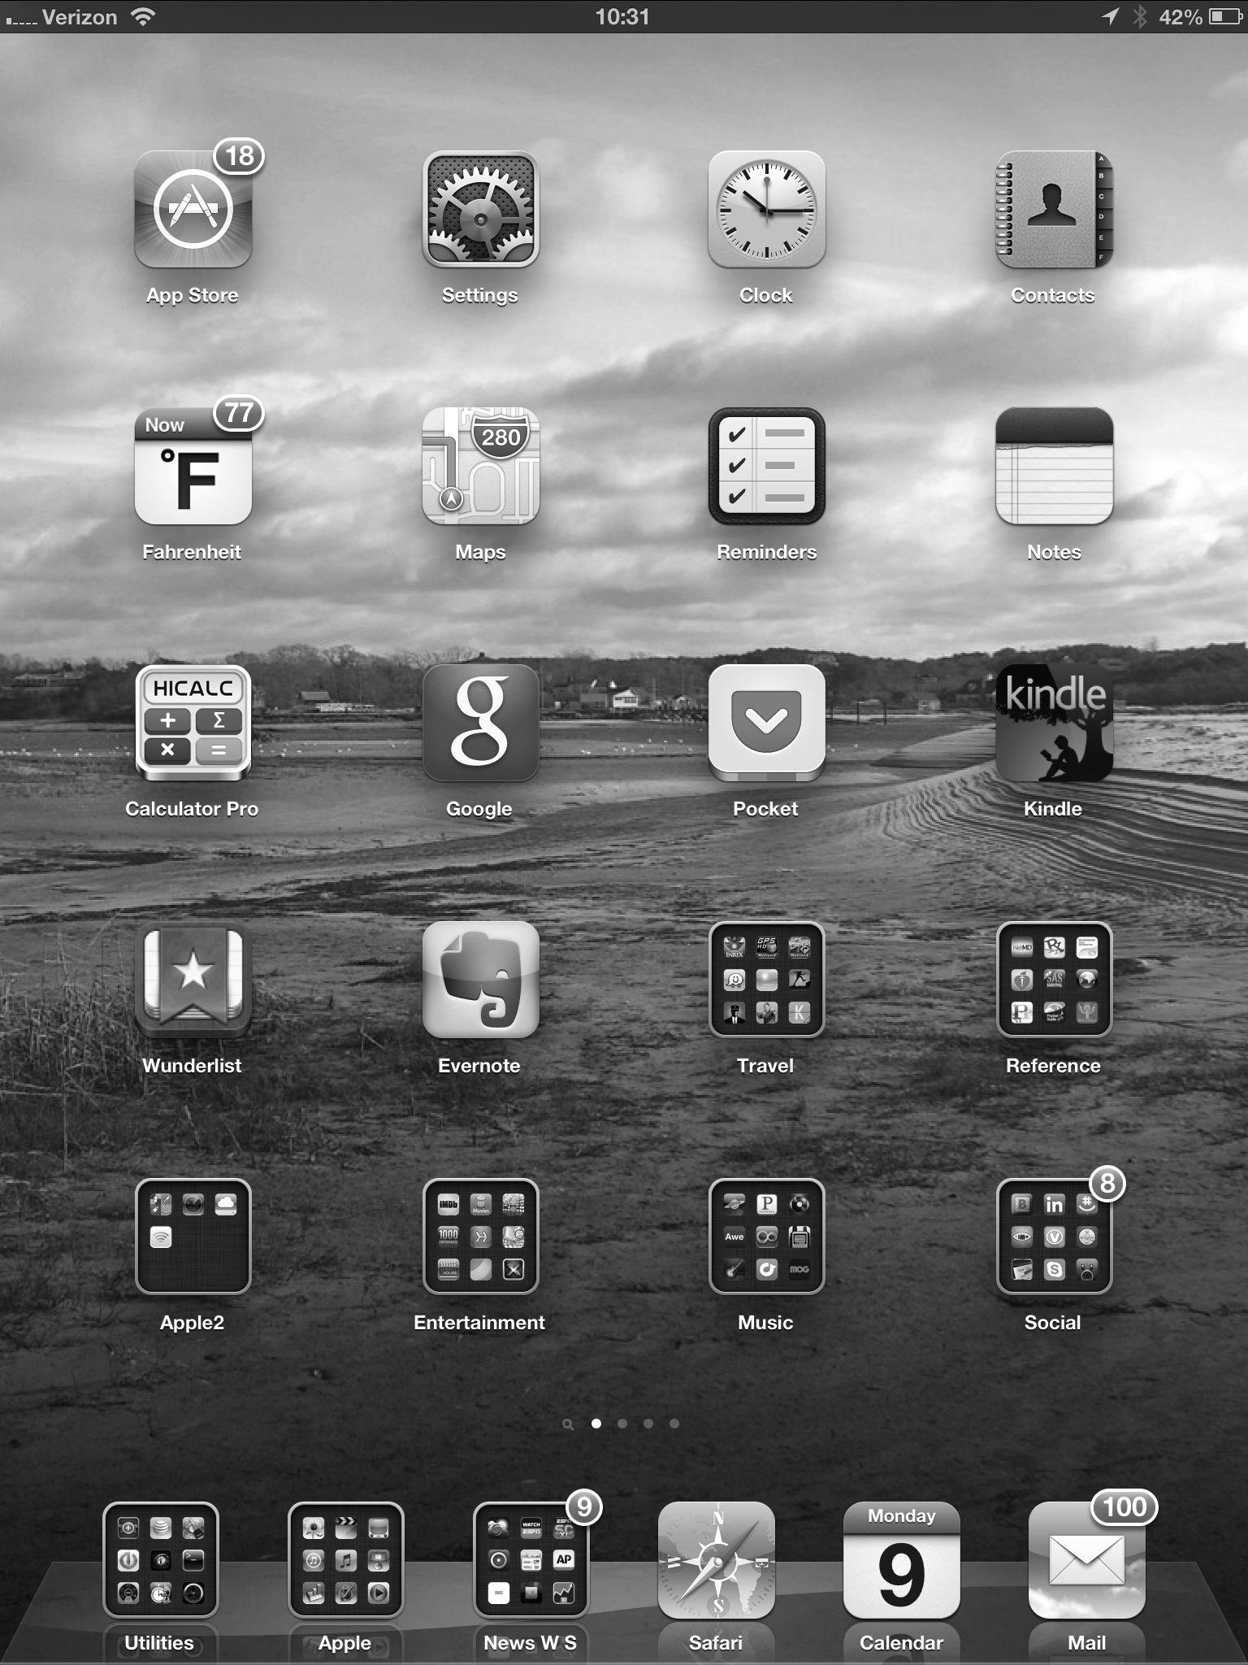
Touchscreen Interfaces
Touchscreen devices require new interfaces
Mouse not possible or not desired
Actions and selection based on gestures
Virtual keyboard for text entry
Voice commands.
Notes:
25

Slide 26
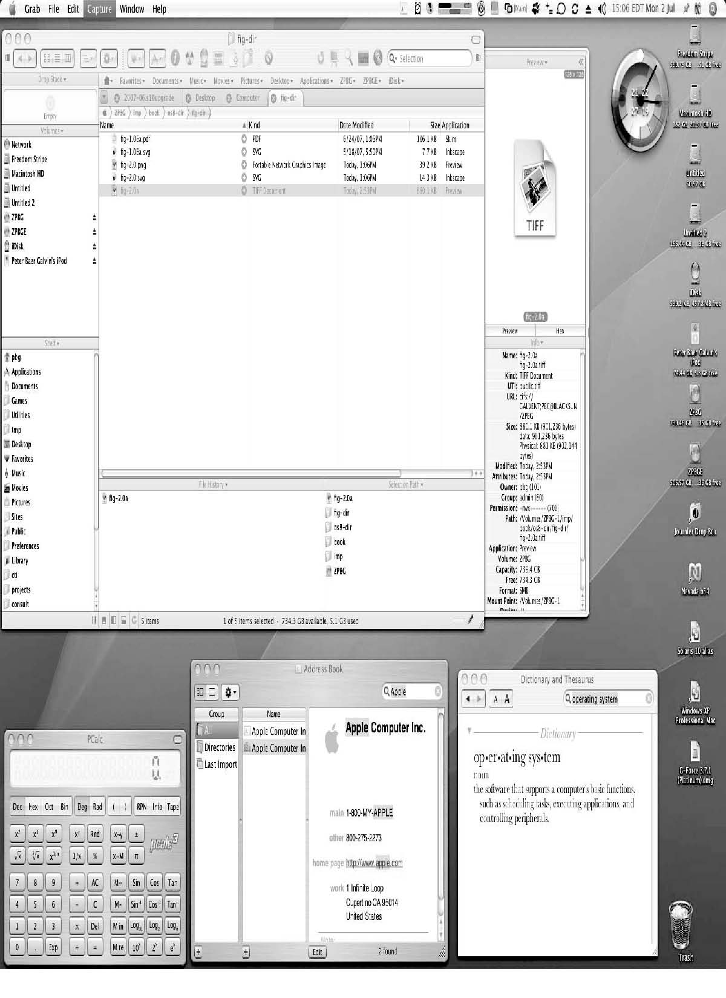
The Mac OS X GUI

Slide 27
System Calls
Programming interface to the services provided by the OS
Typically written in a high-level language (C or C++)
Mostly accessed by programs via a high-level Application Programming Interface (API) rather than direct system call use
Three most common APIs are Win32 API for Windows, POSIX API for POSIX-based systems (including virtually all versions of UNIX, Linux, and Mac OS X), and Java API for the Java virtual machine (JVM)
Notes:
27

Slide 28
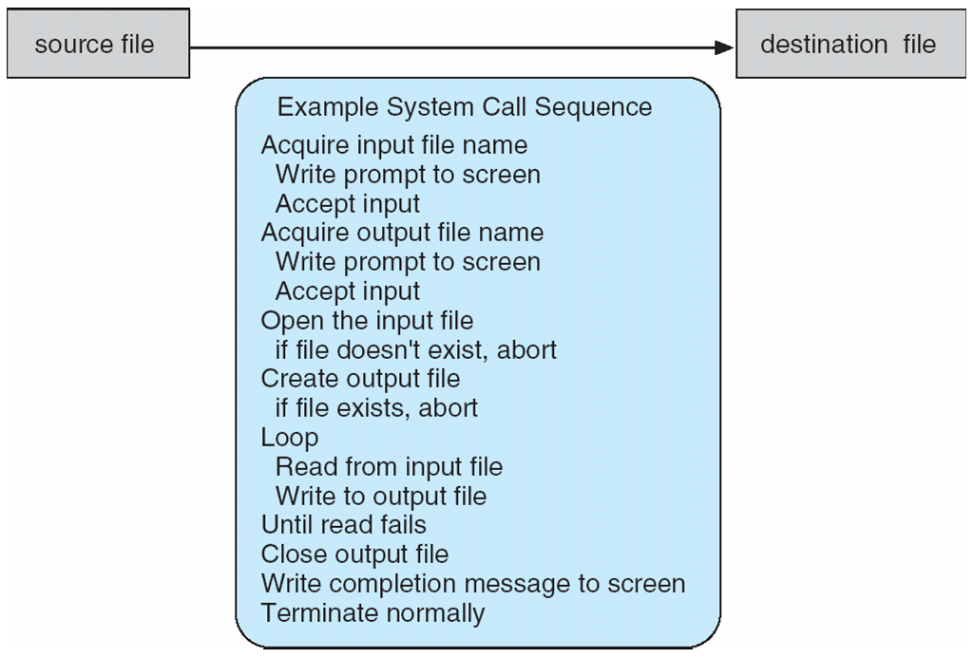
Example of System Calls
System call sequence to copy the contents of one file to another file
Notes:
28

Slide 29
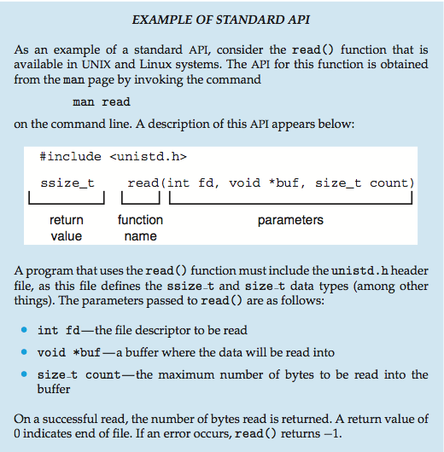
Example of Standard API
Notes:
29

Slide 30
System Call Implementation
Typically, a number associated with each system call
System-call interface maintains a table indexed according to these numbers
The system call interface invokes the intended system call in OS kernel and returns status of the system call and any return values
The caller need know nothing about how the system call is implemented
Just needs to obey API and understand what OS will do as a result call
Most details of OS interface hidden from programmer by API
Managed by run-time support library (set of functions built into libraries included with compiler)
Notes:
30

Slide 31
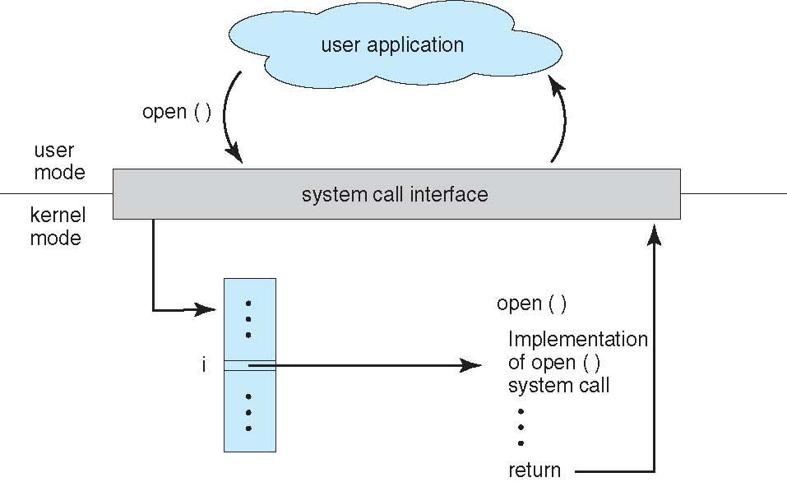
API – System Call – OS Relationship
Notes:
31

Slide 32
System Call Parameter Passing
Often, more information is required than simply identity of desired system call
Exact type and amount of information vary according to OS and call
Three general methods used to pass parameters to the OS
Simplest: pass the parameters in registers
In some cases, may be more parameters than registers
Parameters stored in a block, or table, in memory, and address of block passed as a parameter in a register
This approach taken by Linux and Solaris
Parameters placed, or pushed, onto the stack by the program and popped off the stack by the operating system
Block and stack methods do not limit the number or length of parameters being passed
Notes:
32

Slide 33
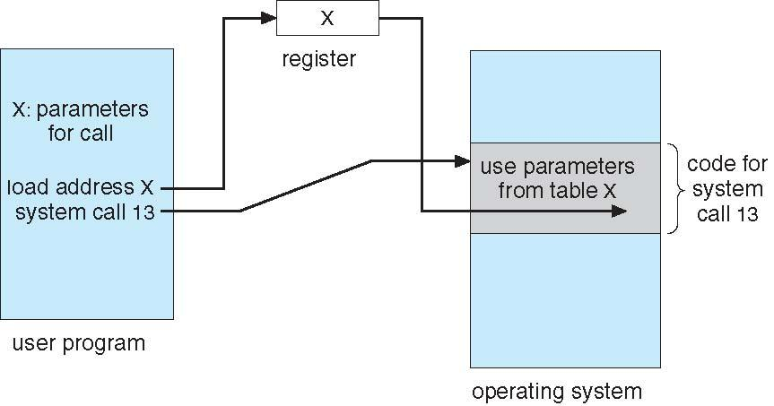
Parameter Passing via Table
Notes:
33

Slide 34
Types of System Calls
Process control
create process, terminate process
end, abort
load, execute
get process attributes, set process attributes
wait for time
wait event, signal event
allocate and free memory
Dump memory if error
Debugger for determining bugs, single step execution
Locks for managing access to shared data between processes
Notes:
34

Slide 35
Types of System Calls
File management
create file, delete file
open, close file
read, write, reposition
get and set file attributes
Device management
request device, release device
read, write, reposition
get device attributes, set device attributes
logically attach or detach devices
Notes:
35

Slide 36
Types of System Calls (Cont.)
Information maintenance
get time or date, set time or date
get system data, set system data
get and set process, file, or device attributes
Communications
create, delete communication connection
send, receive messages if message passing model to host name or process name
From client to server
Shared-memory model create and gain access to memory regions
transfer status information
attach and detach remote devices
Notes:
36

Slide 37
Types of System Calls (Cont.)
Protection
Control access to resources
Get and set permissions
Allow and deny user access
Notes:
37

Slide 38
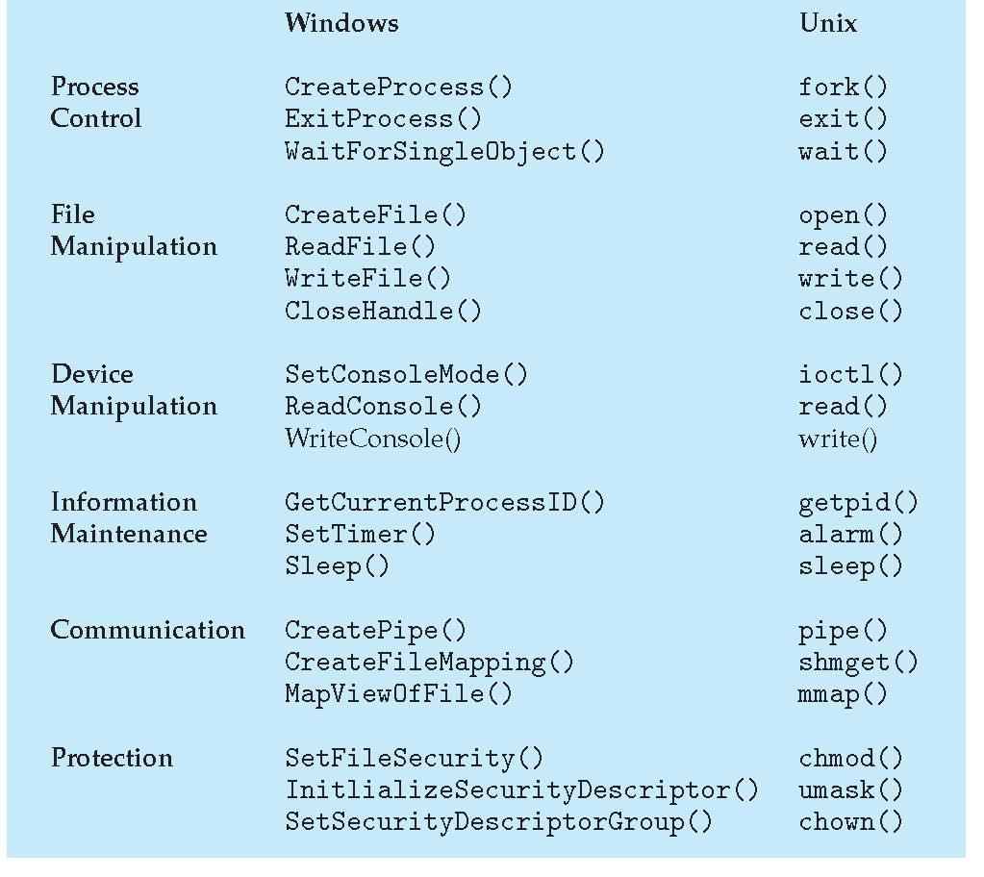
Examples of Windows and Unix System Calls

Slide 39
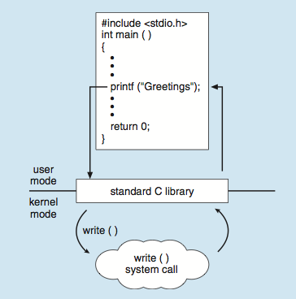
Standard C Library Example
C program invoking printf() library call, which calls write() system call
Notes:
39

Slide 40
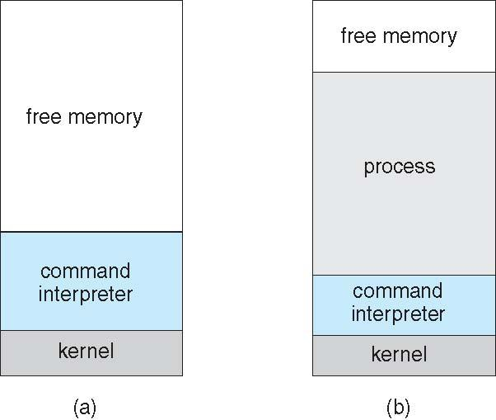
Example: MS-DOS
Single-tasking
Shell invoked when system booted
Simple method to run program
No process created
Single memory space
Loads program into memory, overwriting all but the kernel
Program exit -> shell reloaded
At system startup running a program

Slide 41
System Programs
System programs provide a convenient environment for program development and execution. They can be divided into:
File manipulation
Status information sometimes stored in a File modification
Programming language support
Program loading and execution
Communications
Background services
Application programs
Most users’ view of the operation system is defined by system programs, not the actual system calls
Notes:
41

Slide 42
System Programs
Provide a convenient environment for program development and execution
Some of them are simply user interfaces to system calls; others are considerably more complex
File management - Create, delete, copy, rename, print, dump, list, and generally manipulate files and directories
Status information
Some ask the system for info - date, time, amount of available memory, disk space, number of users
Others provide detailed performance, logging, and debugging information
Typically, these programs format and print the output to the terminal or other output devices
Some systems implement a registry - used to store and retrieve configuration information
Notes:
42

Slide 43
System Programs (Cont.)
File modification
Text editors to create and modify files
Special commands to search contents of files or perform transformations of the text
Programming-language support - Compilers, assemblers, debuggers and interpreters sometimes provided
Program loading and execution- Absolute loaders, relocatable loaders, linkage editors, and overlay-loaders, debugging systems for higher-level and machine language
Communications - Provide the mechanism for creating virtual connections among processes, users, and computer systems
Allow users to send messages to one another’s screens, browse web pages, send electronic-mail messages, log in remotely, transfer files from one machine to another
Notes:
43

Slide 44
System Programs (Cont.)
Background Services
Launch at boot time
Some for system startup, then terminate
Some from system boot to shutdown
Provide facilities like disk checking, process scheduling, error logging, printing
Run in user context not kernel context
Known as services, subsystems, daemons
Application programs
Don’t pertain to system
Run by users
Not typically considered part of OS
Launched by command line, mouse click, finger poke
Notes:
44

Slide 45
MCQs
Notes:
45

Slide 46
MCQs
Which kernel design places most OS services in kernel space? A. Microkernel B. Monolithic kernel C. Hybrid kernel D. Exokernel
In which kernel type are device drivers, file systems, and system services implemented as user-level processes? A. Monolithic kernel B. Hybrid kernel C. Microkernel D. Nanokernel
Which of the following is an advantage of a microkernel architecture? A. Faster system calls B. Larger kernel size C. Improved system stability D. Direct hardware access for applications Linux operating system uses which type of kernel? A. Microkernel B. Monolithic kernel C. Hybrid kernel D. Exokernel
5. Which kernel type allows only basic services like IPC and scheduling in kernel space? A. Monolithic B. Hybrid C. Microkernel D. Multikernel
6. Windows NT kernel is best described as a: A. Monolithic kernel B. Microkernel C. Hybrid kernel D. Exokernel

Slide 47
MCQs
7. Which kernel architecture aims to provide minimal abstractions and allow applications direct control over hardware resources? A. Microkernel B. Hybrid kernel C. Exokernel D. Monolithic kernel
8. Which of the following is a key disadvantage of monolithic kernels? A. Poor performance B. Limited scalability C. Low fault tolerance D. High context switching overhead
9. In a hybrid kernel, the design philosophy is to: A. Eliminate kernel mode B. Combine features of monolithic and microkernel designs C. Move all services to user space D. Minimize hardware abstraction
10. Which kernel type is most suitable for research and experimental operating systems? A. Monolithic kernel B. Hybrid kernel C. Microkernel D. Exokernel
11. Which kernel type generally results in faster execution due to fewer context switches? A. Microkernel B. Hybrid kernel C. Monolithic kernel D. Exokernel
12. Which of the following kernels is commonly used in embedded and real-time systems? A. Hybrid kernel B. Microkernel C. Exokernel D. Monolithic kernel

Slide 48
MCQs
13. The kernel of an operating system is responsible for: A. User interface design B. Managing hardware resources C. Compiling programs D. Editing files
14. Which of the following is NOT a function of the kernel? A. Process management B. Memory management C. File management D. Command interpretation
15. Which mode does the kernel operate in? A. User mode B. Supervisor mode C. Kernel mode D. Both B and C
16. The kernel acts as a bridge between: A. Hardware and application software B. User and shell C. Compiler and hardware D. Memory and CPU
17. Which of the following kernel components manages CPU scheduling? A. Memory manager B. Process manager C. I/O manager D. File manager
18. Which kernel component handles allocation and deallocation of memory? A. Scheduler B. Dispatcher C. Memory manager D. Device driver

Slide 49
MCQs
19. The shell in an operating system primarily acts as a: A. Hardware controller B. Command interpreter C. Process scheduler D. Memory allocator
20. Which of the following is an example of a shell? A. Kernel B. BIOS C. Bash D. Loader
21. The shell communicates directly with the: A. Hardware B. Compiler C. Kernel D. User applications
22. Which of the following is NOT a type of shell? A. Bourne shell B. C shell C. PowerShell D. Monolithic shell
23. Which statement is TRUE about kernel and shell? A. Both interact directly with hardware B. Shell is a part of kernel C. Kernel is mandatory, shell is optional D. Kernel and shell are the same
24. The kernel is loaded into memory: A. When a user logs in B. At system boot time C. When shell starts D. When an application runs

Slide 50
MCQs
25. Shell scripts are mainly used to: A. Manage memory B. Control hardware C. Automate command execution D. Schedule processes
26. Which of the following provides security and access control in OS? A. Shell B. Kernel C. Compiler D. Loader
27. In Linux, system calls provide an interface between: A. Shell and user B. Application and kernel C. Kernel and hardware D. Shell and compiler
28. Assertion (A): Kernel is the core of the operating system. Reason (R): Kernel manages hardware resources and system calls.
A. Both A and R are true, and R explains A B. Both A and R are true, but R does not explain A C. A is true, R is false D. A is false, R is true

Slide 51
MCQs
29. What is the output of the following code:
#include <stdio.h>
#include <unistd.h>
int main()
{
if (fork() || fork()):
fork();
printf("1 ");
return 0; }
Answer: 1 1 1 1 1
30. Which of the following is NOT a category of system calls? A. Process control B. File management C. Memory management D. Compiler control

